Slide 1
Enhancing Low-Light Images Using Retinex Theory: An Approach to Illumination Map Estimation through Local Variance Analysis and Reflectance Estimation via Weighted Total Variation
Presenter: Mohammed Saidul Islam, 220232724
Course: EECS 6154 [Project]

Slide 2
Content
Retinex Theory
Retinex Theory based low-light image enhancement process
Methods of enhancing low-light images using retinex theory in literature
Proposed Approach
Initial Illumination Estimation
Estimation of Reflectance with Weighted Total Variation
Final Results

Slide 3



Retinex Theory
The Retinex theory [1, 2] denotes that any observed image, denoted as , can be represented as a pixel-by-pixel multiplication of the two components, the reflectance component , and the illumination component . This is depicted as:
Here, encapsulates the scene's inherent attributes, including details and the color characteristics of the original scene, whereas corresponds to the light's intensity and its spatial distribution within the scene's environment.

Slide 4



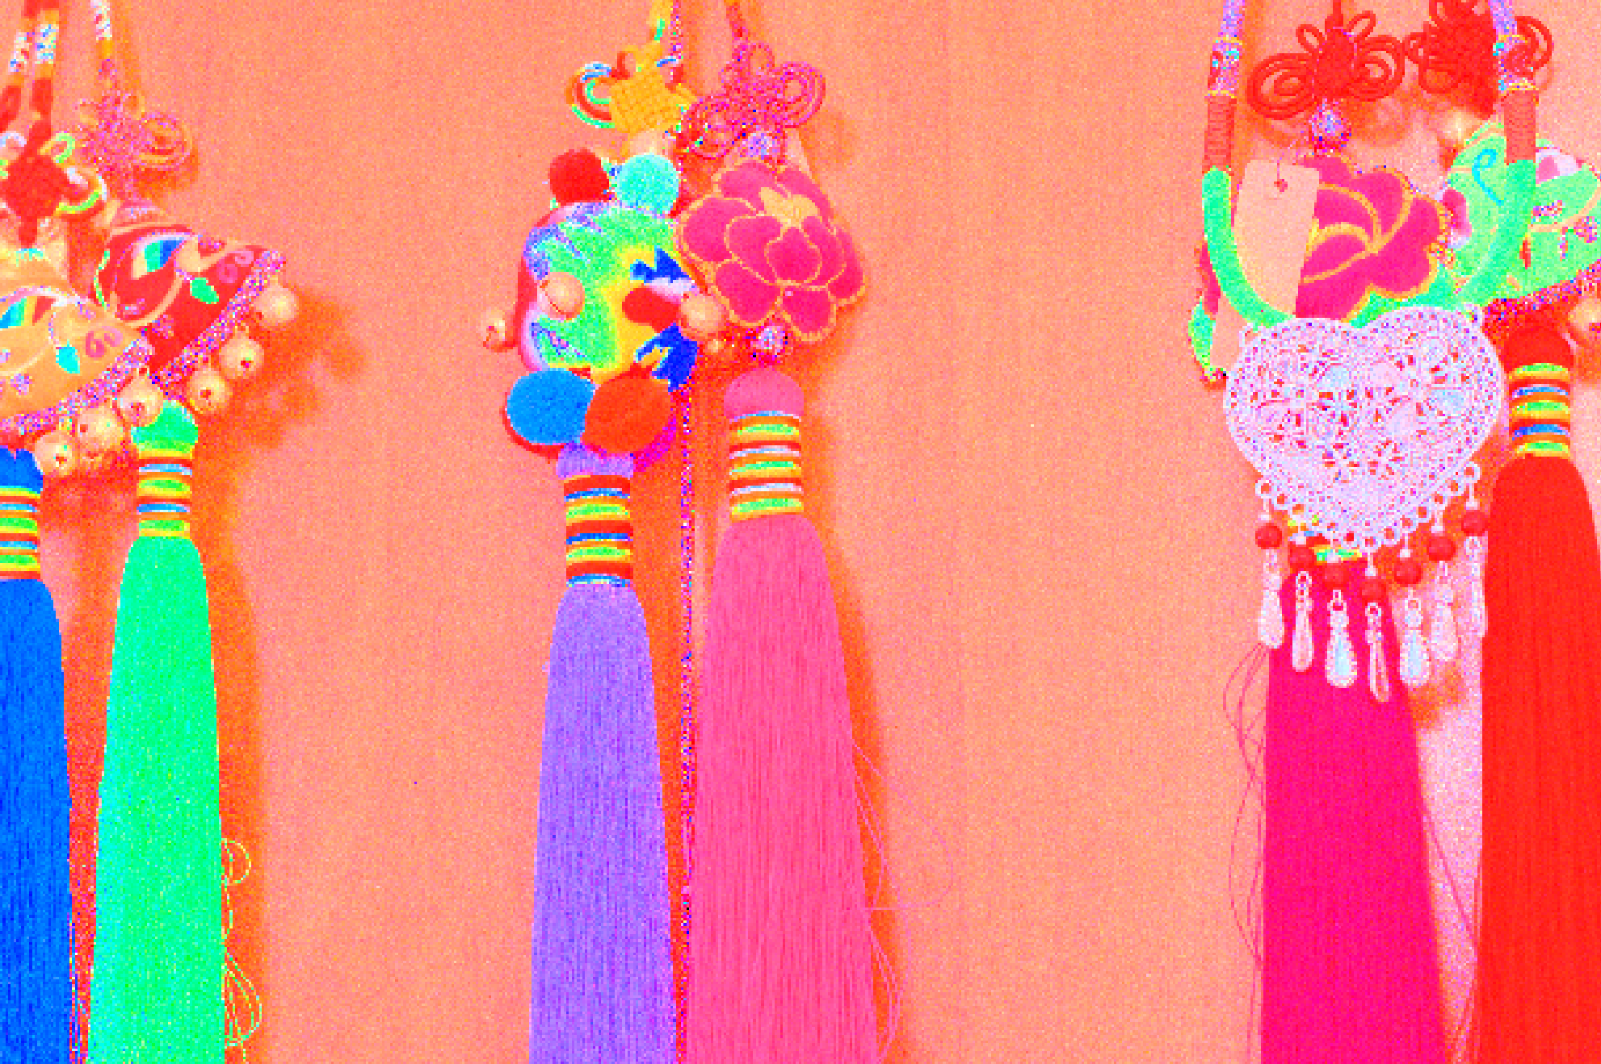
Retinex Theory based low-light image enhancement process
Initial Illumination Estimation
Further processing with methods (i.e., HE, CLAHE, Tikhonov Regularization, Graph based processing etc.)
Input Low light image
Final version
Further processing with methods (i.e., TV, Gamma correction, Graph based processing etc.)
Initial Reflectance Estimation

Slide 5
Methods of enhancing low light images via estimation of Illumination and Reflectance components in literature
Various methods have been proposed to estimate the Reflectance component and the Illumination component
Many approaches [4, 6] compute these estimation via solving an optimization problem
Researchers have also proposed variational methods such as Total Variation, L1-variational method [7] to estimate the different components
Some recent studies [5] introduced graph based techniques to estimate the Illumination and Reflectance component
With the advances in Deep Learning techniques, recent works have focused on data driven techniques to estimate the illumination and reflectance component, however, these techniques rely on datasets which are often synthetic and limited in size

Slide 6
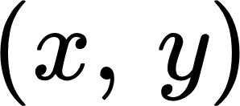
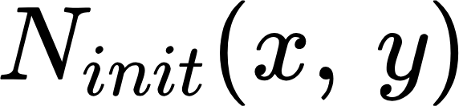
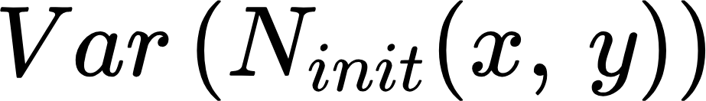
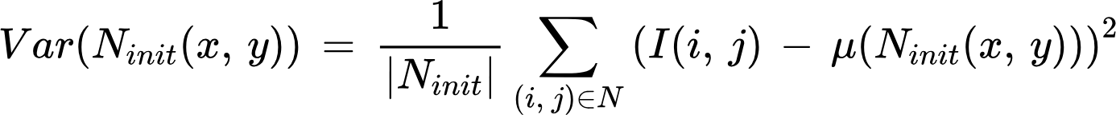

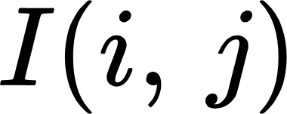
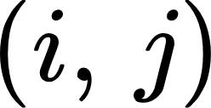
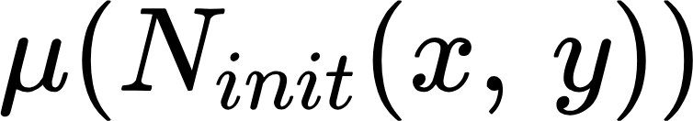
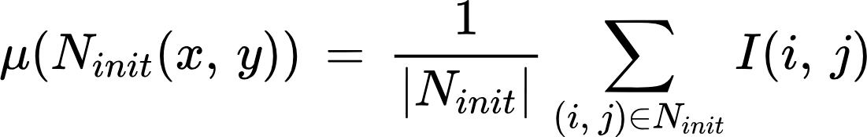
Proposed Approach (Initial Illumination Estimation)
Pixel Neighborhood Analysis with Adaptive Neighborhood size
Given an image , for each pixel at location , an initial neighborhood is defined which is a square region of size (neighborhood_size)×(neighborhood_size) centered at
The variance within this neighborhood is calculated as:
where: is the number of pixels in the neighborhood, is the intensity of the pixel at
is the mean intensity of the pixels in the neighborhood, calculated as:

Slide 7
Proposed Approach
Pixel Neighborhood Analysis with Adaptive Neighborhood size
Next, based on the result of initial variance calculation, a new neighborhood size is selected based on the following criteria,
If is greater than variance_threshold, then a small neighborhood size (3x3) is selected
The small neighborhood size indicates the presence of piecewise smoothness with sharp discontinuities

Slide 8
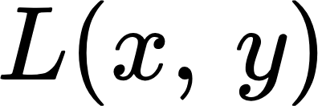
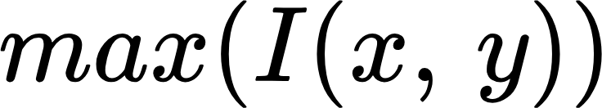
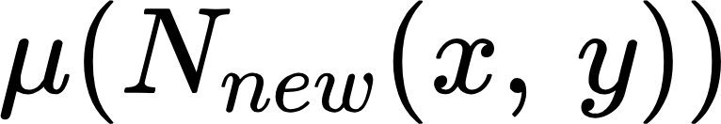
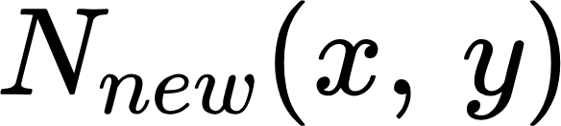
Proposed Approach
Constructing the Illumination component
Finally, for each pixel at , we compare the neighborhood_size,
If neighborhood_size > small_neighborhood_size, the pixel is assumed to be part of a smoothly varying region (illumination), and its value in the illumination component is set to the maximum of the intensity value across three channels [with the assumption that the illumination is at least the maximal value of three channels at a certain location]
If neighborhood_size == small_neighborhood_size, the pixel is in a region with significant variation (more likely reflectance), and its value in is set to the average intensity of its neighborhood, which is calculated as .
where is the newly selected neighborhood size.
​

Slide 9
Proposed Approach
Constructing the Reflectance component
For each pixel at , the reflectance component is constructed as,
​

Slide 10

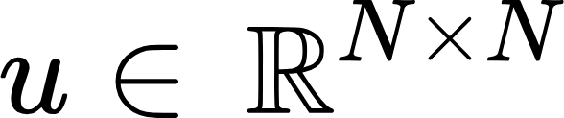
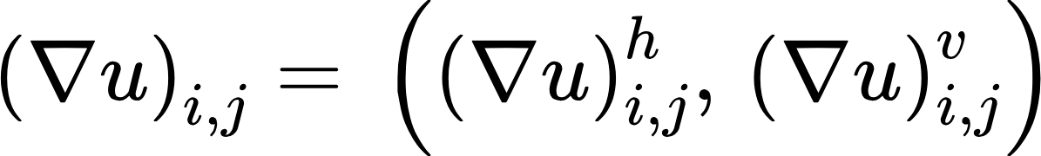
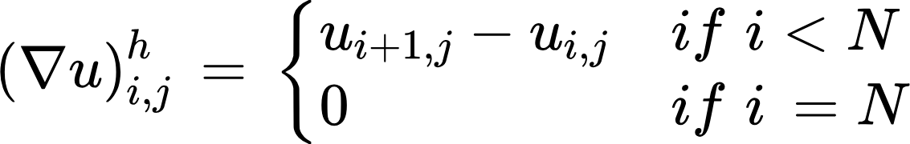
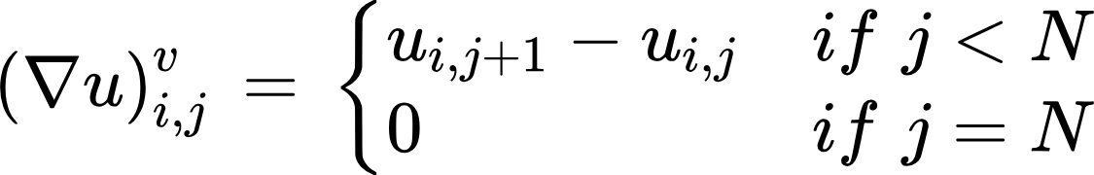
Proposed Approach
A weighted version of the Total Variation Denoising for Reflectance estimation
A discrete gradient operator for an image is defined by,
where,
​

Slide 11

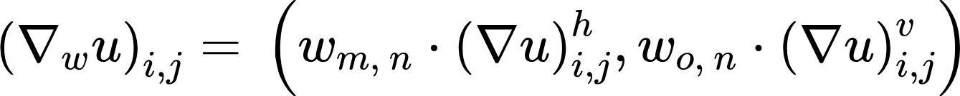

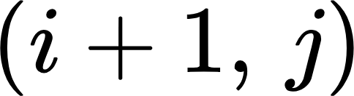

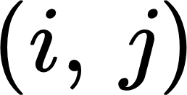

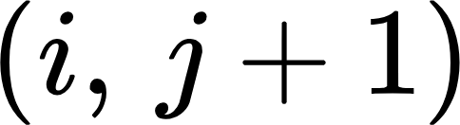
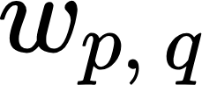
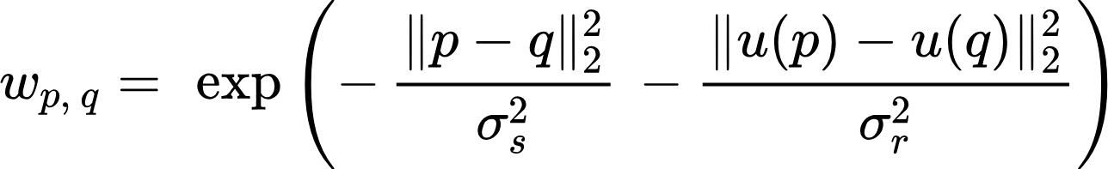
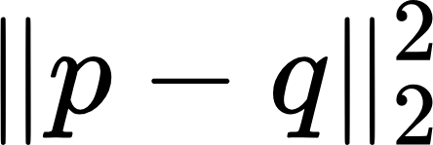

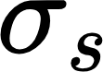
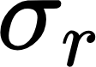
Proposed Approach
A weighted version of the Total Variation Denoising for Reflectance estimation
The weighted version of the discrete gradient operator would be,
​
where corresponds to coordinate , corresponds to and corresponds to
Here, the weight is defined as,
where is the euclidean distance between two pixels and is the pixel intensity difference and and are smoothing parameters

Slide 12
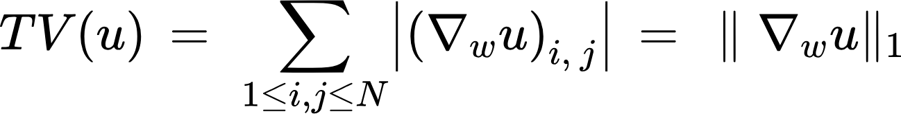
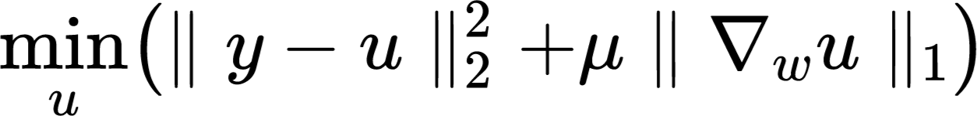
Proposed Approach
A weighted version of the Total Variation Denoising for Reflectance estimation
The total variation will be calculated as,
​
The optimization equation becomes,
This equation is then solved via ADMM and Proximal Gradient method to estimate the reflectance component

Slide 13
Proposed Approach
Estimating the Illumination component and contrast enhancement
If the illumination component becomes too noisy initially, the Tikhonov regularization is employed in order to perform denoising operation on the illumination component
Finally, to enhance the contrast of the overall image, the Contrast Limited Histogram Equalization (CLAHE) is applied.

Slide 14
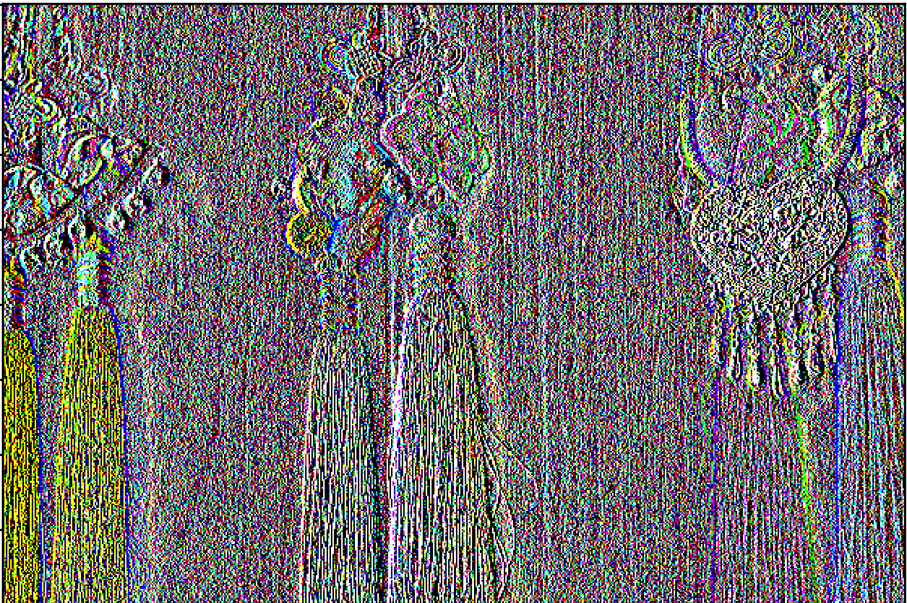
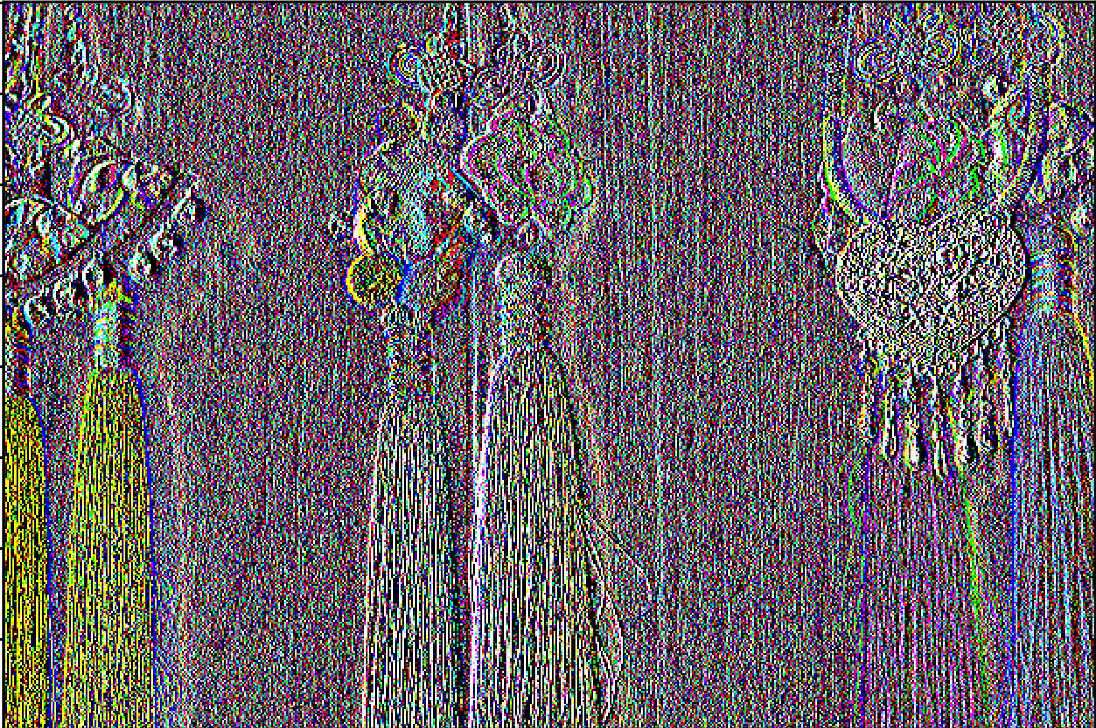
Final Results (Comparison of Horizontal and Vertical Gradient of an image with and without weight)
Original Low light Image
Horizontal Gradient without weight
Horizontal Gradient with weight

Slide 15
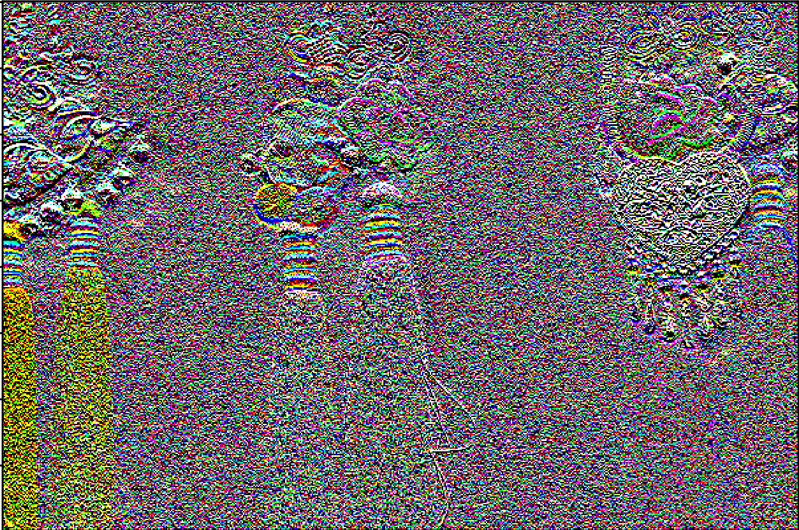
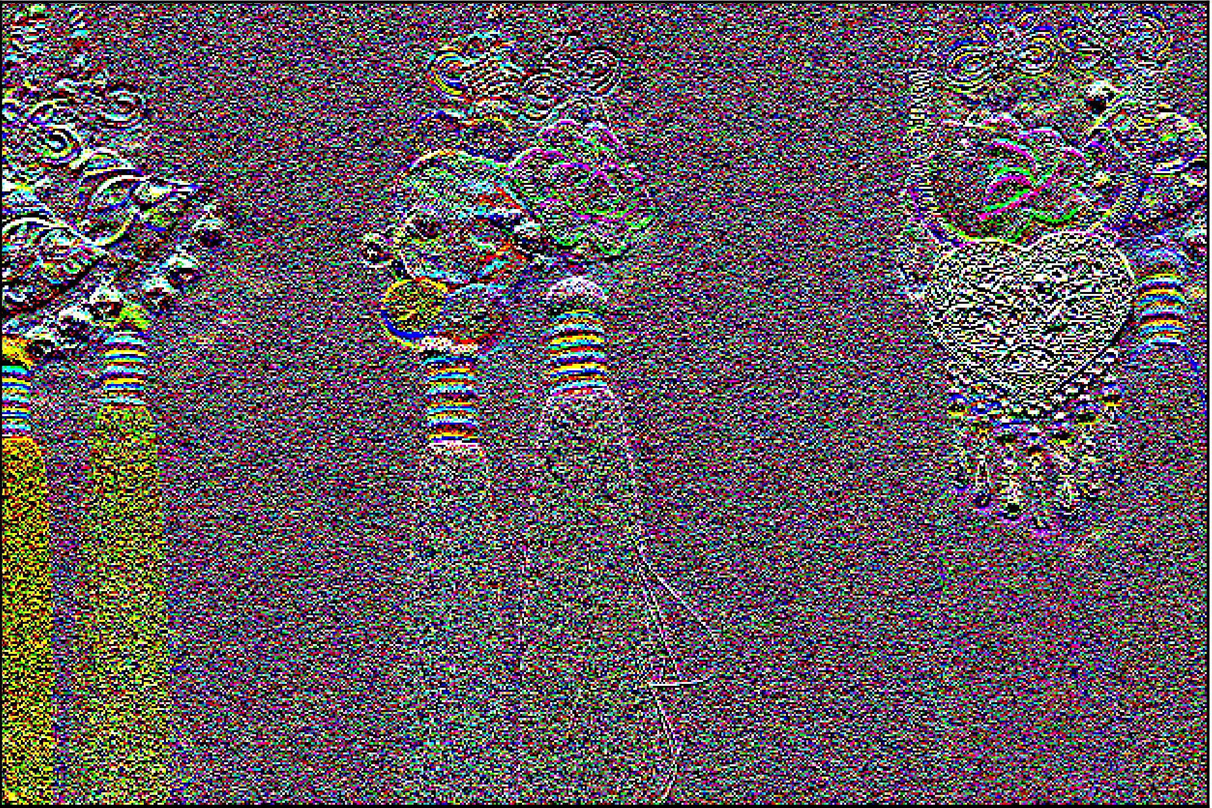
Final Results (Comparison of Horizontal and Vertical Gradient of an image with and without weight)
Original Low light Image
Vertical Gradient without weight
Vertical Gradient with weight

Slide 16
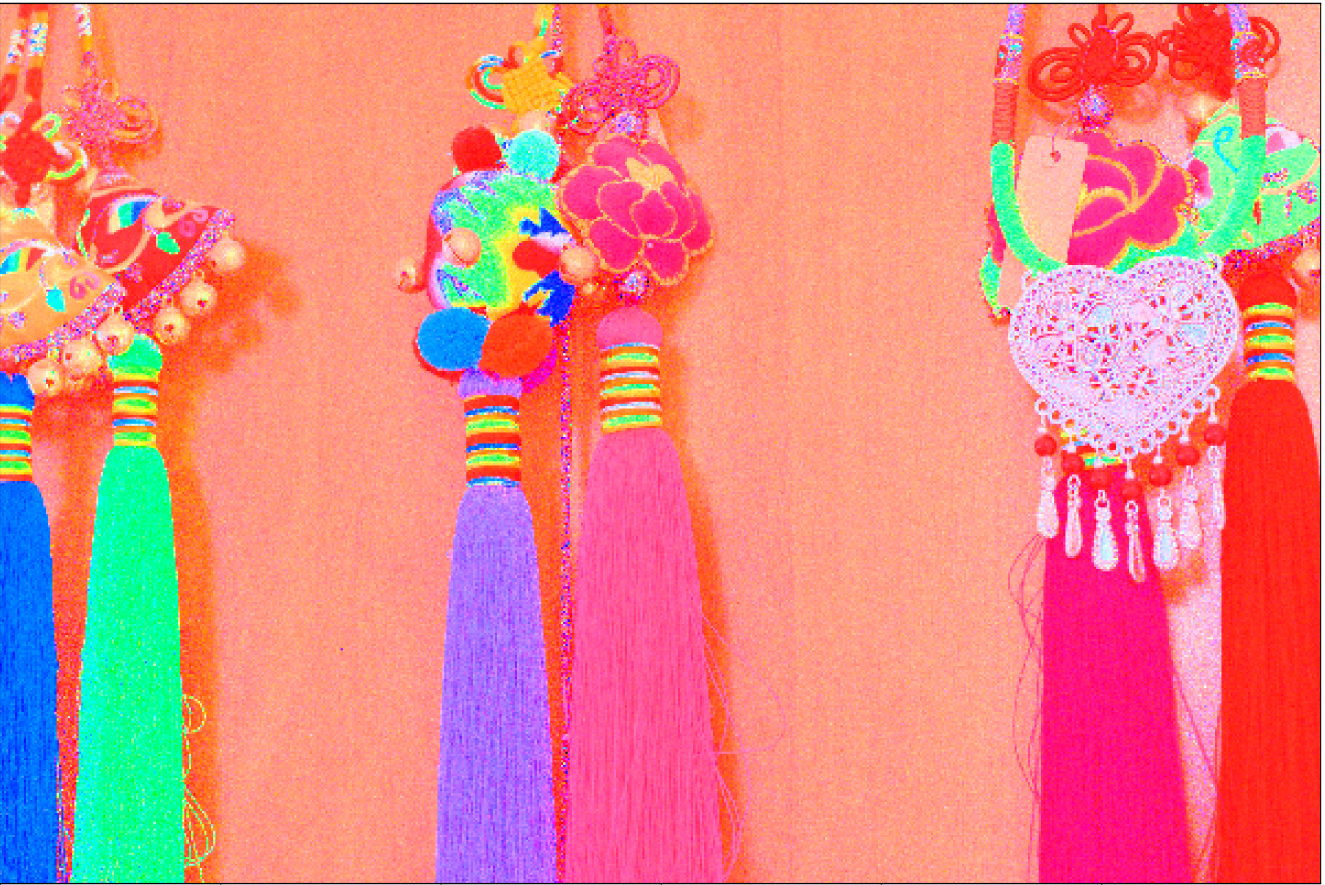

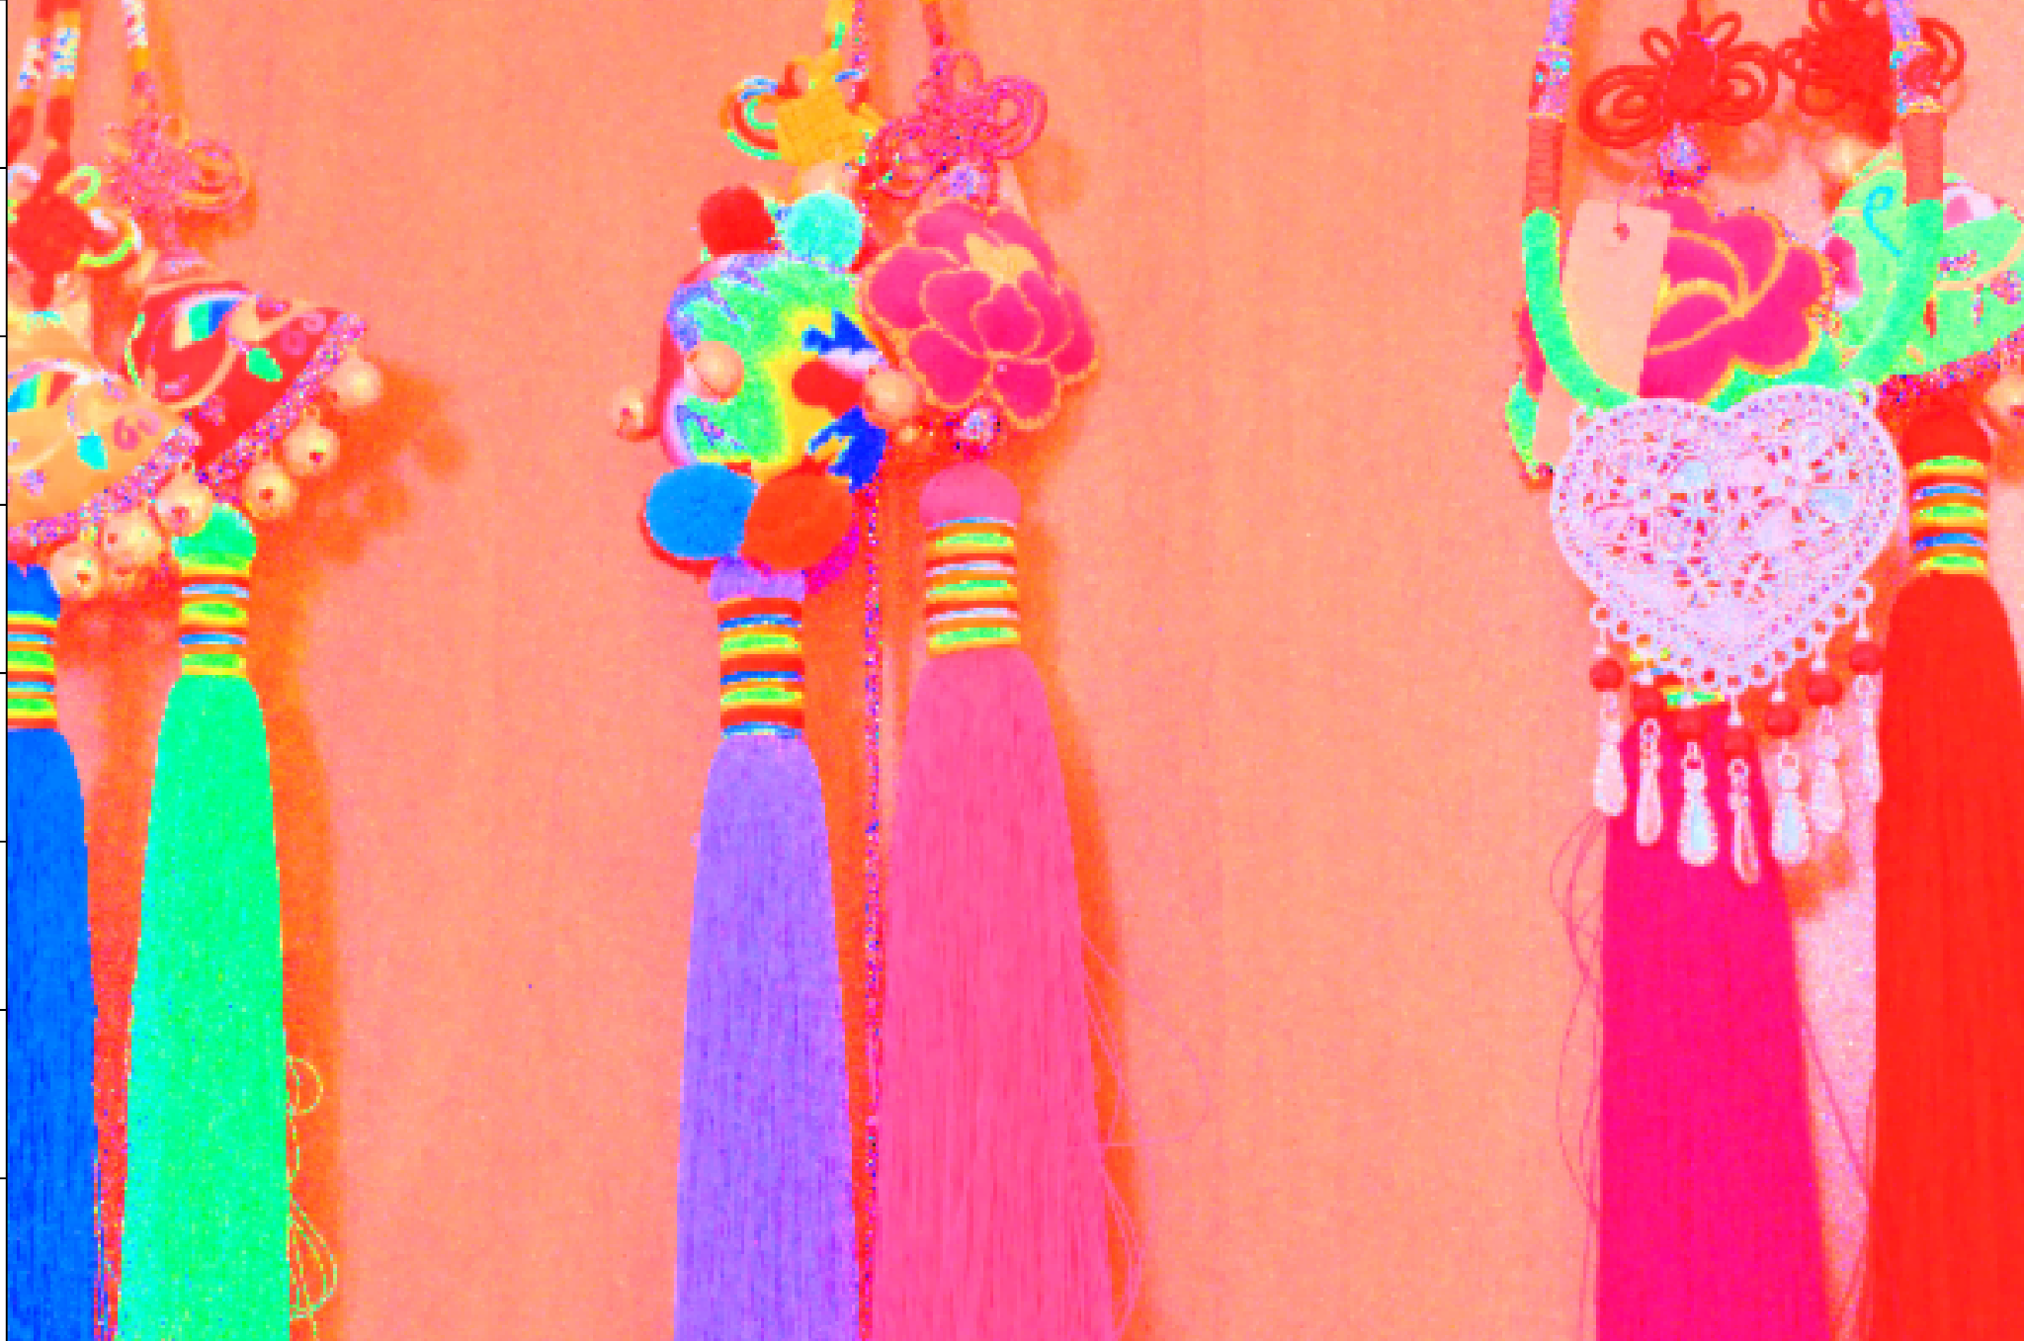
Final Results (Initial Reflectance vs Regular TV vs Weighted TV)
Initial Reflectance
Denoising via Regular TV
Denoising via Weighted TV

Slide 17


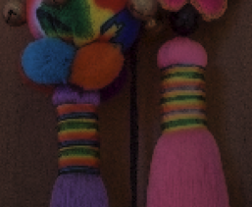
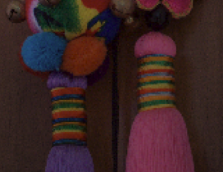
Final Results
Original Low light Image
After enhanced contrast (without weighted TV)
After enhanced contrast (with weighted TV more color accurate and less noisy)

Slide 18
References
E. H. Land and J. J. McCann, “Lightness and Retinex theory,” J. Opt. Soc. Amer., vol. 61, no. 1, pp. 1–11, 1971.
T. Wu, W. Wu, Y. Yang, F. -L. Fan and T. Zeng, "Retinex Image Enhancement Based on Sequential Decomposition With a Plug-and-Play Framework," in IEEE Transactions on Neural Networks and Learning Systems, doi: 10.1109/TNNLS.2023.3280037.
X. Ren, W. Yang, W. -H. Cheng and J. Liu, "LR3M: Robust Low-Light Enhancement via Low-Rank Regularized Retinex Model," in IEEE Transactions on Image Processing, vol. 29, pp. 5862-5876, 2020, doi: 10.1109/TIP.2020.2984098.
Wei, Chen, Wenjing Wang, Wenhan Yang, and Jiaying Liu. "Deep retinex decomposition for low-light enhancement." arXiv preprint arXiv:1808.04560 (2018).
Gharedaghi, Yeganeh, Gene Cheung, and Xianming Liu. "Retinex-based Image Denoising/Contrast Enhancement Using Gradient Graph Laplacian Regularizer." In 2023 IEEE International Conference on Image Processing (ICIP), pp. 2710-2714. IEEE, 2023.
Guo, X., Li, Y., & Ling, H. (2016). LIME: Low-light image enhancement via illumination map estimation. IEEE Transactions on image processing, 26(2), 982-993.
W. Ma, J. -M. Morel, S. Osher and A. Chien, "An L1-based variational model for Retinex theory and its application to medical images," CVPR 2011, Colorado Springs, CO, USA, 2011, pp. 153-160, doi: 10.1109/CVPR.2011.5995422.

Slide 19
Thank You

Slide 20



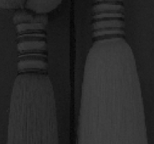
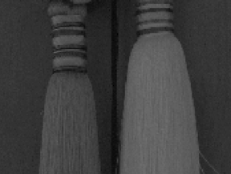
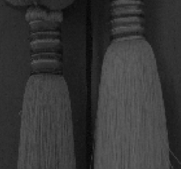
Results
Comparison of Illumination component between other methods
Neighborhood variance method
(more smooth than others)
maxRGB
meanRGB

Slide 21
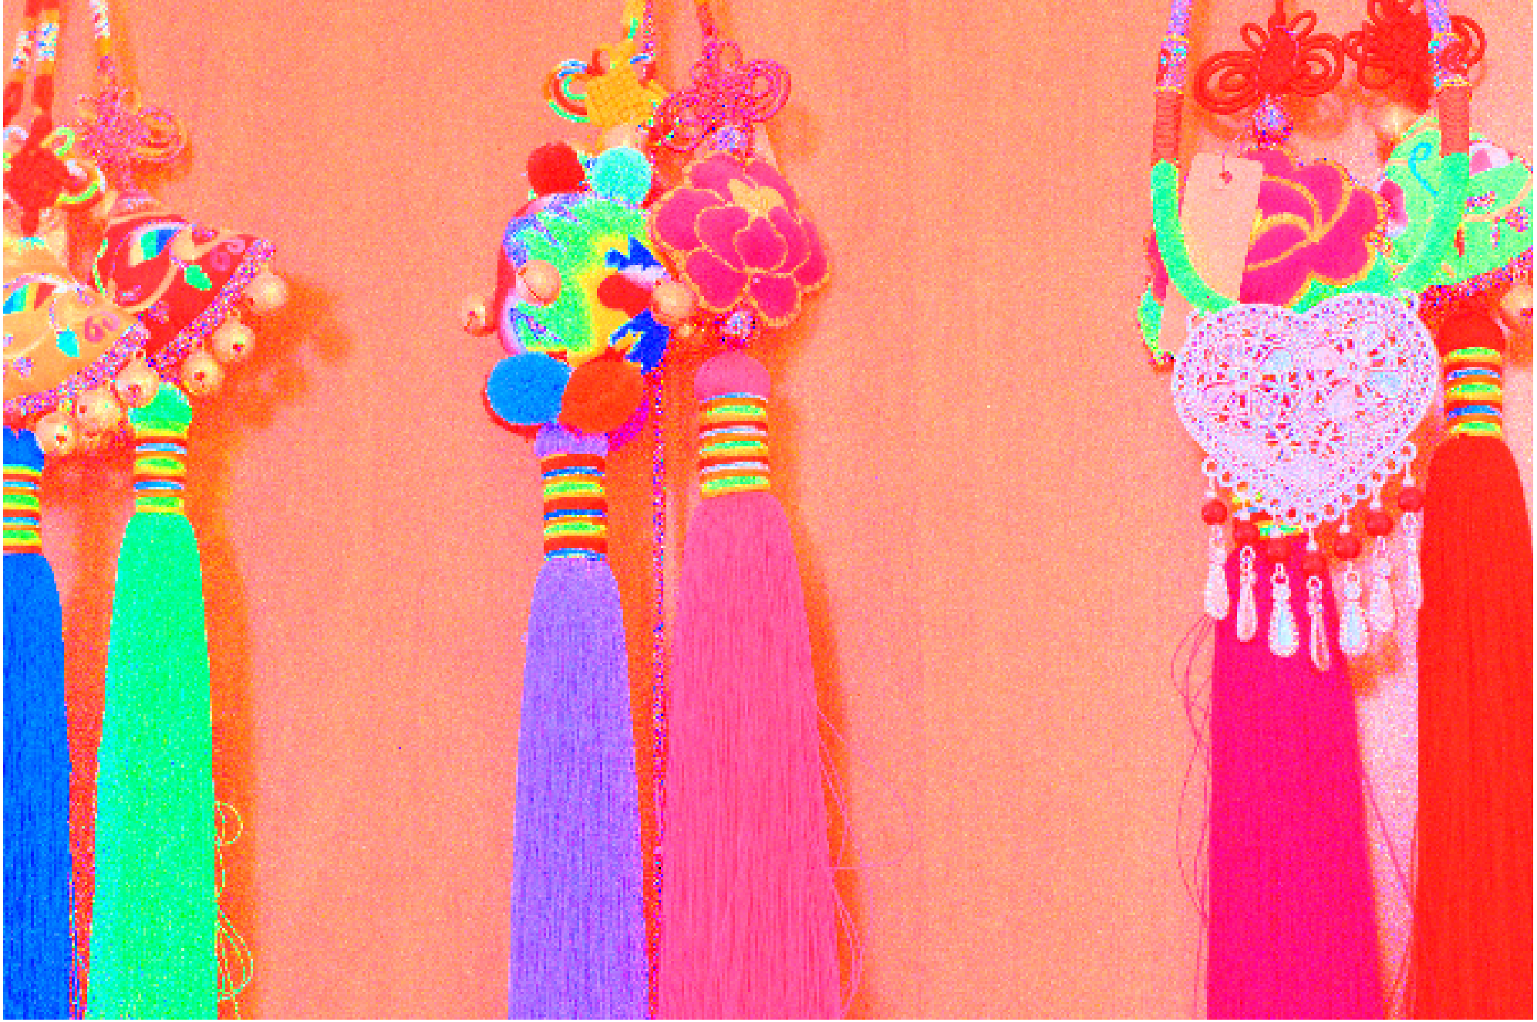
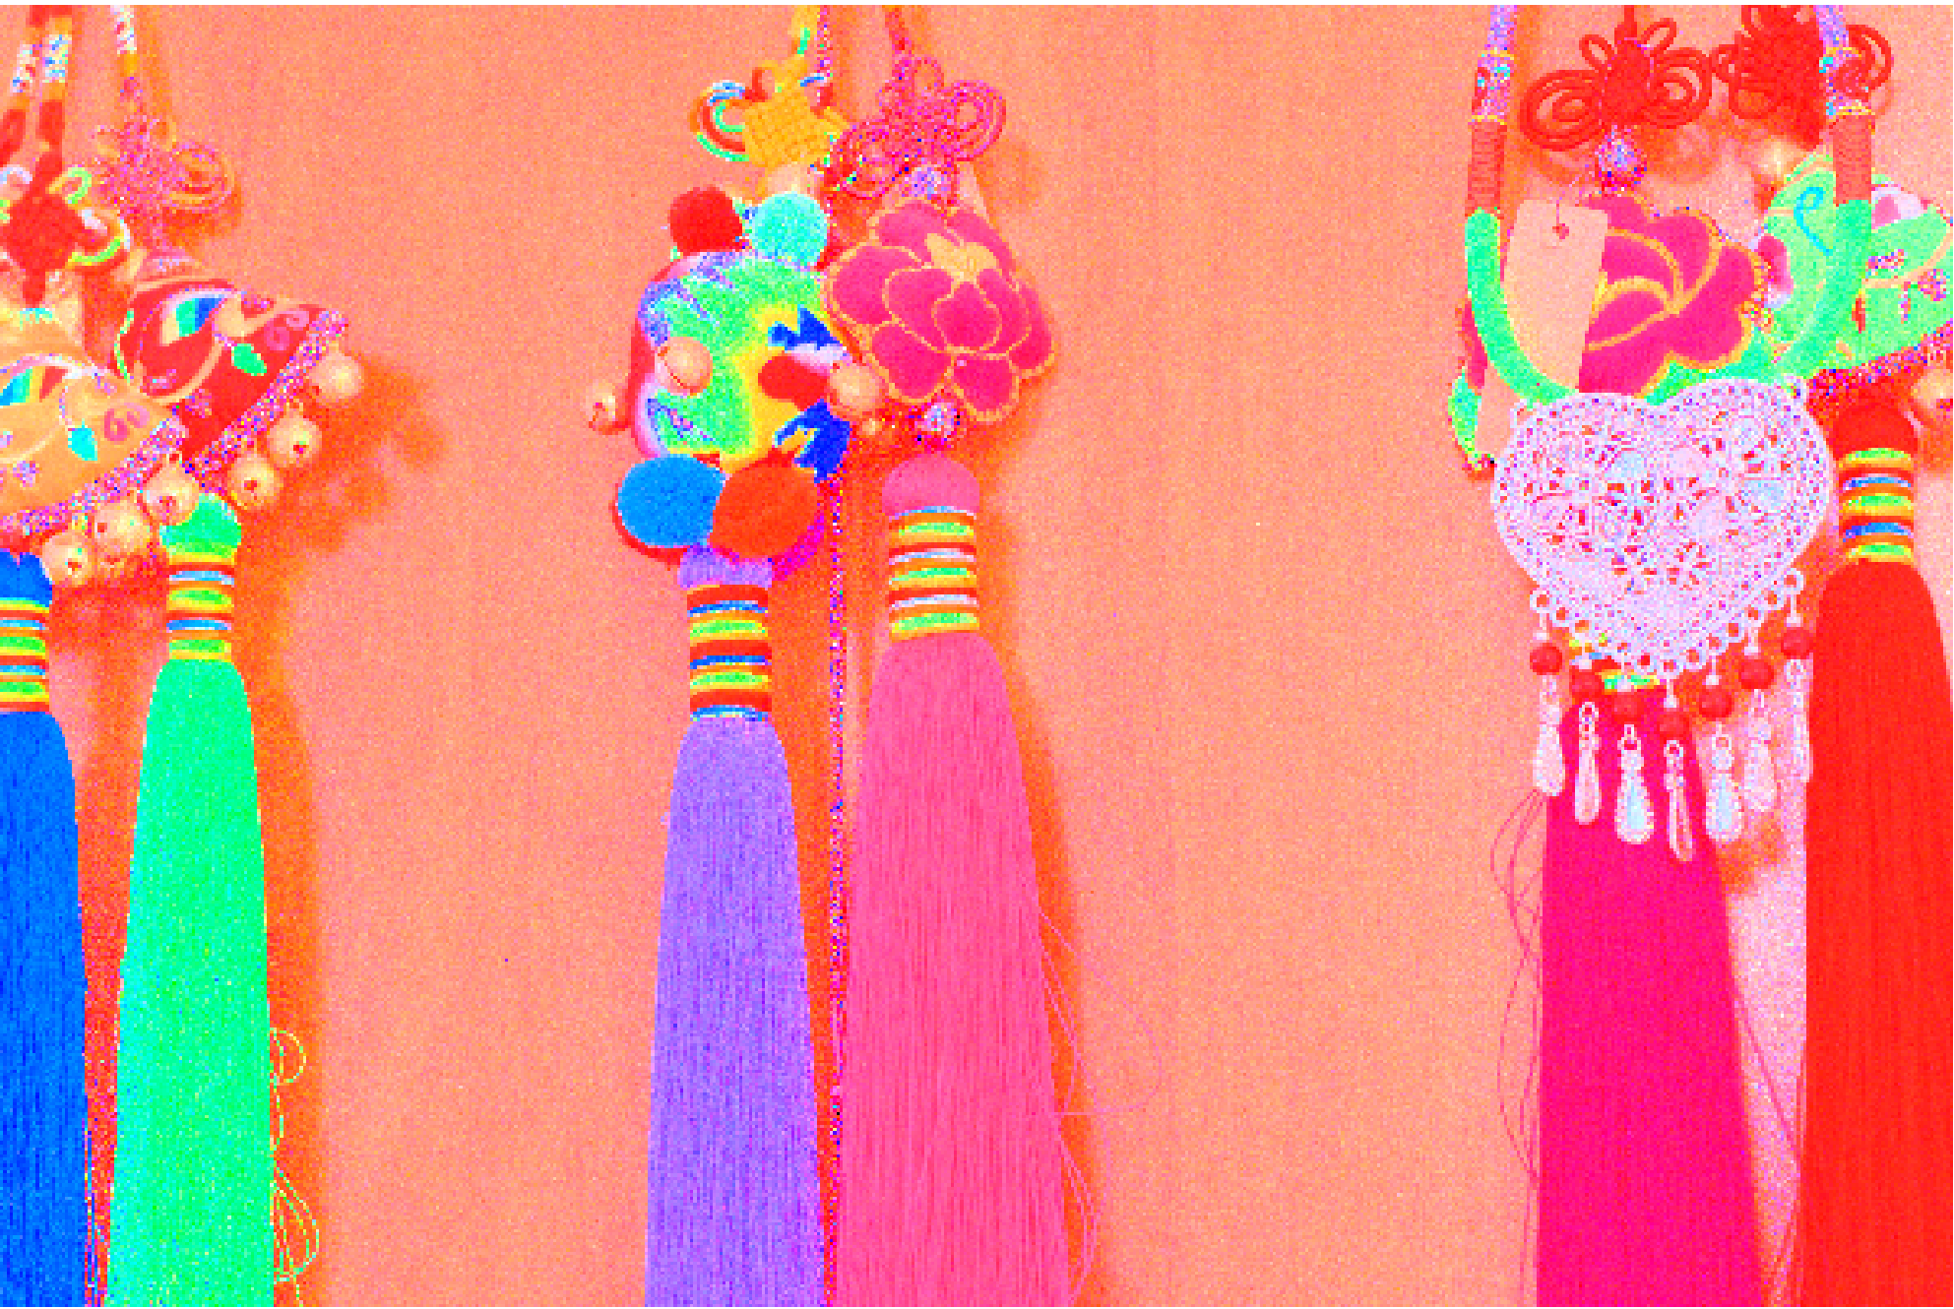




Results
Comparison of Reflectance component between other methods
Neighborhood variance method
(less noisy while preserving the details)
maxRGB
meanRGB

